Slide 1
Capstone Project
Regression - Bike Sharing Demand Prediction
By Paras

Slide 2
Summary & Problem Statement
A bike sharing service is the one in which a person lends bikes for other people on rent. This can sometimes be a shop where the lender receives payment for providing bikes for use. Nowadays we have an unmanned system in which bikes are available at docks which the user can go to & rent a bike & pay digitally online. In this project we are going to analyse the given dataset for valuable insights that might help the company improve their profits by analyzing various factors given in the dataset. We are also going to deploy a regression model to predict the count of rented bikes which may include a few more steps.
Bike sharing is an important means of travelling in today's world , so it's quite necessary for the bike rental services to provide their services on time. We need to create a system which can predict Bike rental demand based on users behaviour.

Slide 3
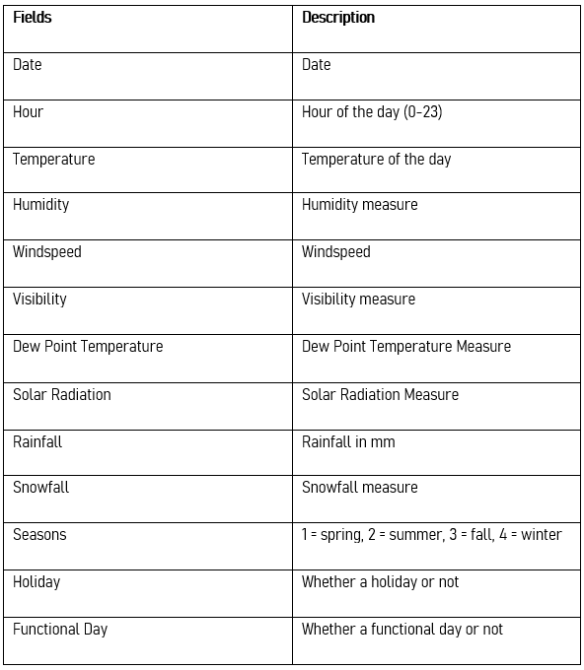
Understanding the data
There are around 8760 entries with the following variables :-

Slide 4
Workflow
We will approach our project in the following steps :-
Data Discovery - In this step we import data & understand the data, its variables, values etc
Data Wrangling - In this step we modify the data so that it becomes ready for next procedures
Exploratory Data Analysis - in this step we create a bunch of charts & graphs to gain insights on the dataset that can help us making better decisions for our rental business.
Model Building - in this step we will try multiple machine learning models & test it to choose the best one. We will also do hyperparameter tuning to find the best parameters for our selected model

Slide 5
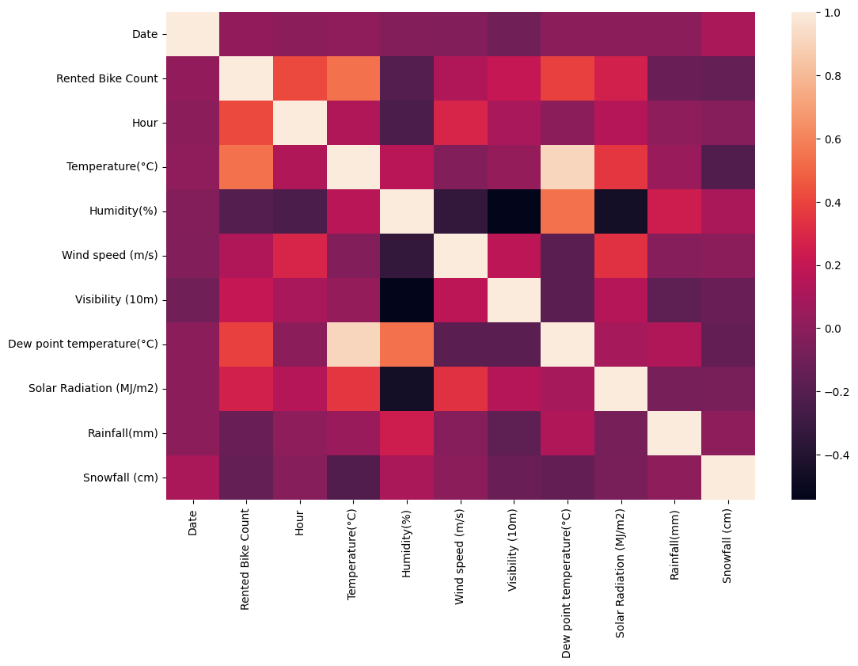
Correlation heatmap

Slide 6
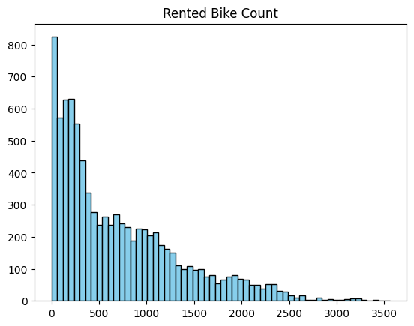
Univariate analysis - Rented bike count
Histograms are better for univariate analysis of numerical values
Mostly, the count of rented bikes lies between , 0 to 500

Slide 7
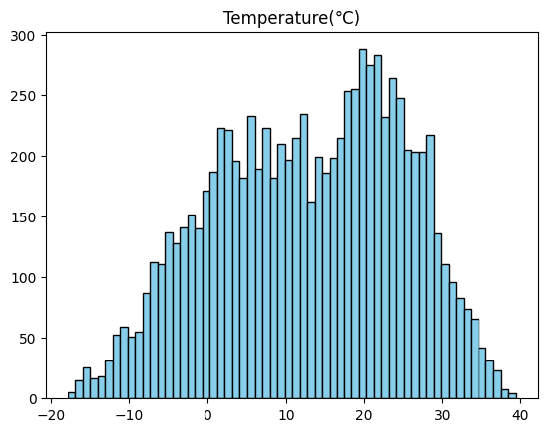
Temperature
Histograms are best for univariate analysis of numerical values
usually the temperature lies between 0 to 30 degree celsius

Slide 8
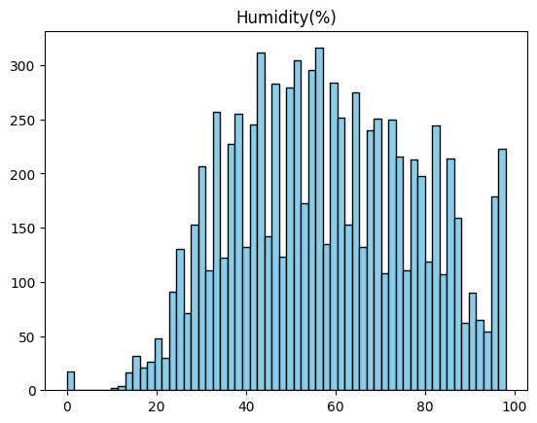
Humidity
v
Histograms are best for univariate analysis of numerical values
mostly humidity lies between 40-80%

Slide 9
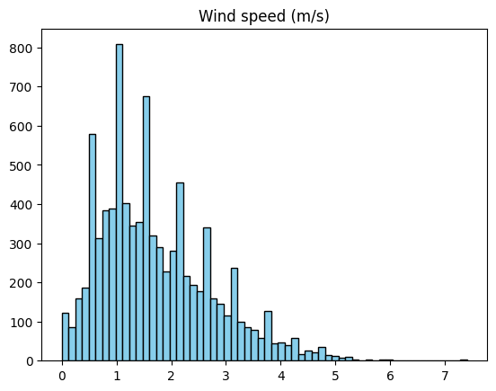
Wind Speed
Histograms are best for univariate analysis of numerical values
Usually the wind speed is between 0 -2 m/s

Slide 10
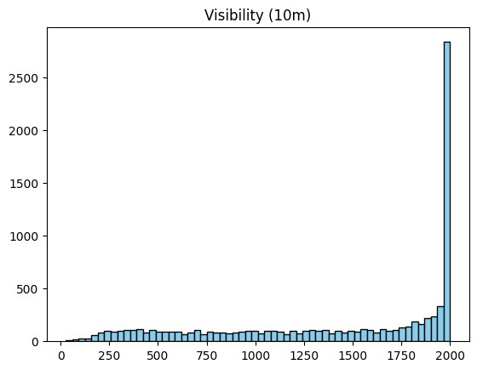
Visibility
Histograms are best for univariate analysis of numerical values
People are more likely to rent when visibility is highest at 2000

Slide 11
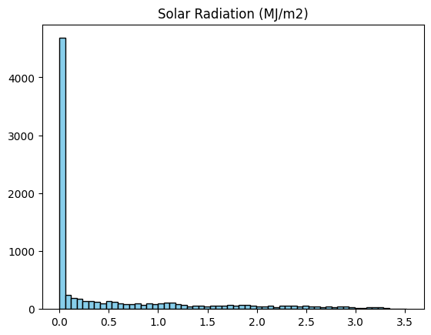
Solar radiation
Histograms are best for univariate analysis of numerical values
People prefer to rent bikes when there is least solar radiation

Slide 12
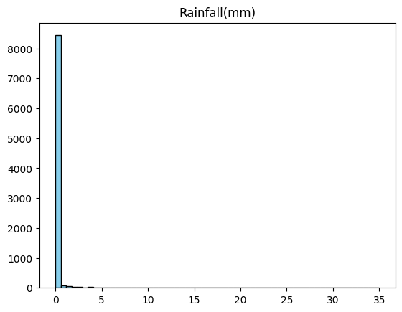
RainFall
Histograms are best for univariate analysis of numerical values
People prefer to rent when the rainfall is least

Slide 13
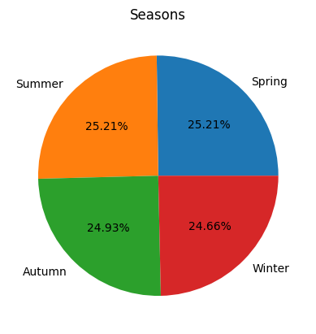
Seasons
Pie chart is best to display the categorical values in the form of parts-to-whole manner
Winter has lowest biker rent count & summers has highest rent count, probably because days are shorter in winter & longer in summers

Slide 14
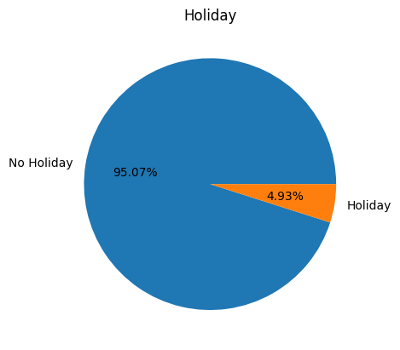
Holiday
Pie chart is best to display the categorical values in the form of parts-to-whole manner
there's more demand for bikes when there is no holidays

Slide 15
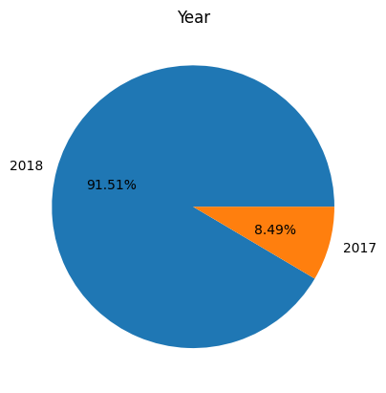
Year
Pie chart is best to display the categorical values in the form of parts-to-whole manner
. What is/are the insight(s) found from the chart?
2018 was busier than 2017 when it comes to bike demand

Slide 16
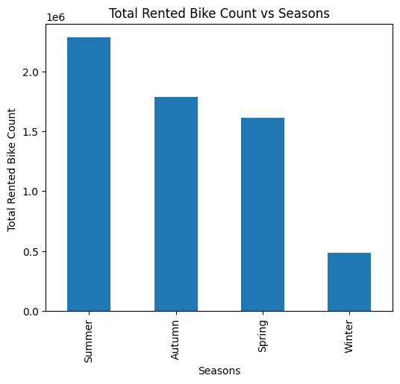
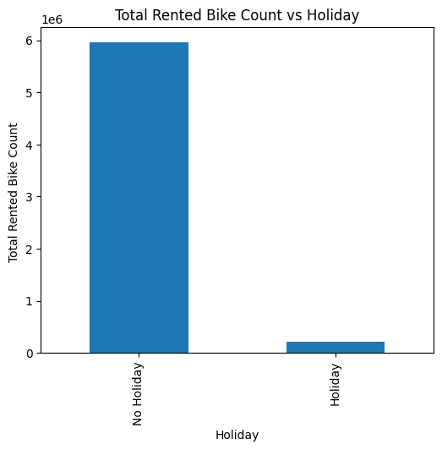
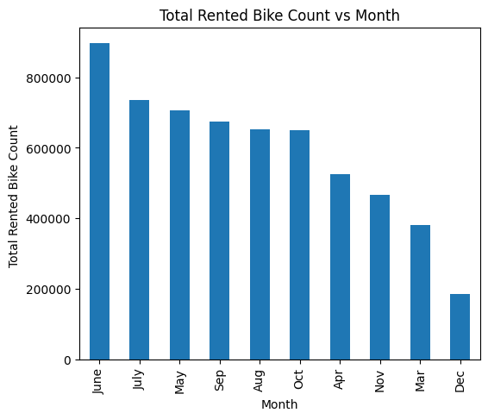
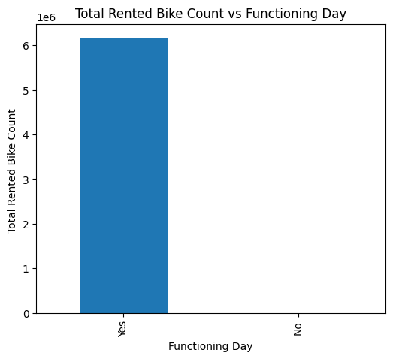
Total rented bike count per each categorical values
summer has more demand than any other seasons
There's more demand when there is no holiday
Functioning days has more demands than non functioning days
June, july, may has highest demand than other months, probably because these are summer months when days are longer
2018 has seen more demand than 2017

Slide 17
Model Implementation - Dummy Encoding
The machine learning models cannot understand categorical values, so we need to convert these categorical values into numerical values , this is where encoding comes in. In encoding we create columns from unique values from the column & place 0 & 1 based on the category in each entry. In dummy encoding, 1 column is skipped to reduce curse of dimensions.The next slide shows how new columns are made by encoding.

Slide 18
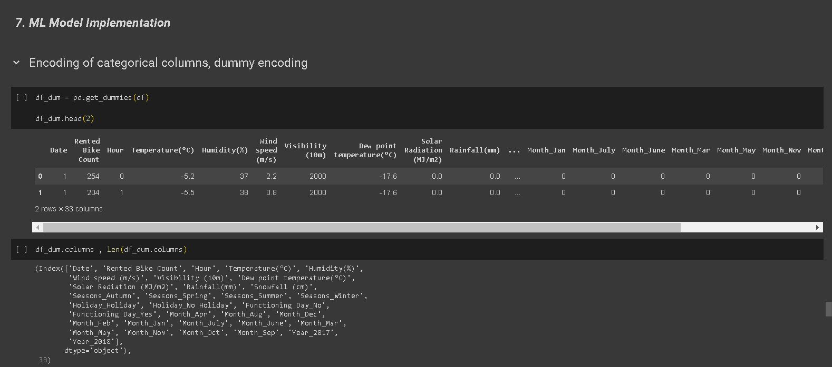

Slide 19
Defining features & train-test split
Here we will define inputs features & output/target variables, then we will do the train test split. We have kept the test size as 0.2 that means 20% of the data will be kept as testing data which will be used in evaluation of the model.

Slide 20
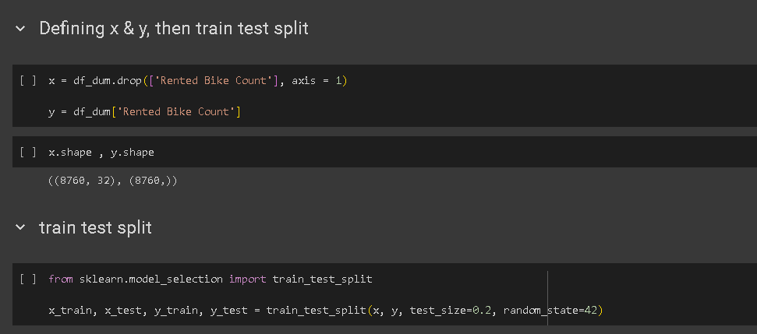

Slide 21
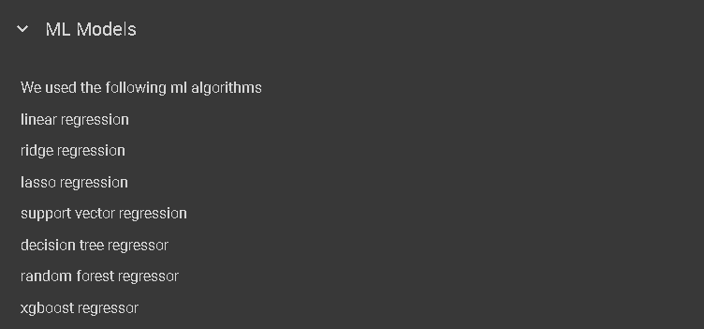
Model Implementation

Slide 22
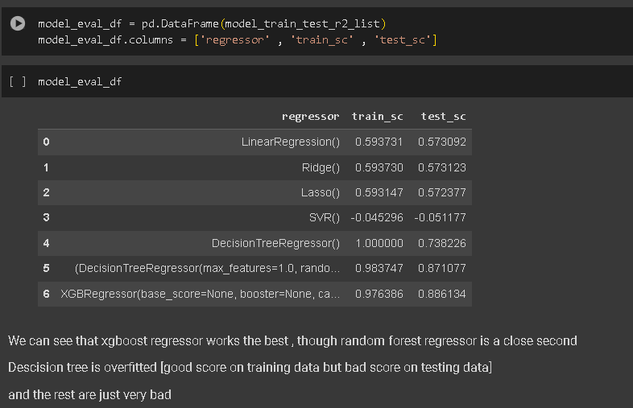
Model Evaluation on training data & testing data

Slide 23
Performance metric used - R2 score
Here we have used r2 score for model evaluation because it is easier to interpret. Its value lies between 0 to 1. The closer the value is to 1 , the better the model is.

Slide 24
Hyperparameter tuning
Hyperparameter tuning is a way by which we can tune our trained model by finding the best parameters for given model. Here we will use randomizedsearch cv wit r2 score for evaluation

Slide 25
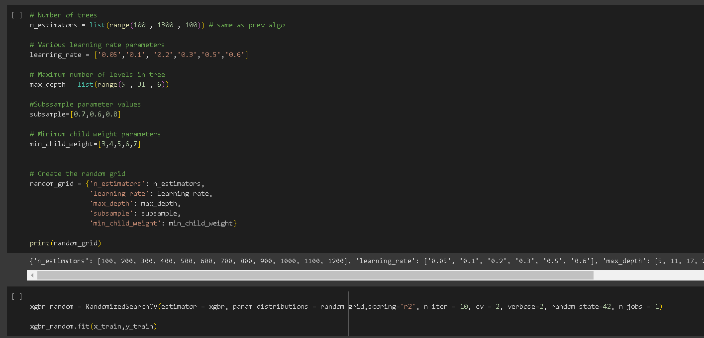

Slide 26
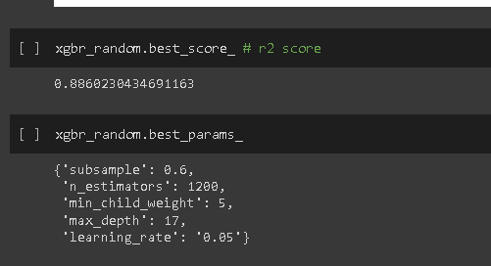
Best score & best parameters

Slide 27
Score analysis
There seems to be not much improvements after hyperparameter tuning.

Slide 28
Thank you

